Slide 1
Project
Image Classification Model

Slide 2
Problem Statement and Understanding
Images are one of the major sources of data in the field of data science and AI. This field is making appropriate use of information that can be gathered through images by examining its features and details.
The idea behind this project is to build a deep learning-based Image Classification model on images that will be scraped from e-commerce portal. This is done to make the model more and more robust.
There are total three categories of image data i.e Saree, Men Trouser and Men Jeans present in the data that would be used to predict the image category. But before using those images to predict the outcome we have collected the data from Amazon.in, cleaned the data, transform the data into structured format. This process ends up with a smooth flow of the data to predict the image category and build the model.
Have used Coding a Convolutional Neural Network (CNN) Using Keras Sequential API to train the data, and built convolutional, pooling and dense layers.

Slide 3
• Mathematical/ Analytical Modelling of the Problem
Identifying sources of the data
Data collection
Data structuring
Analyzing the data
Cleaning and processing the data
Adding convolutional, pooling and dense layers
Evaluating model
Predicting outcome for test data

Slide 4
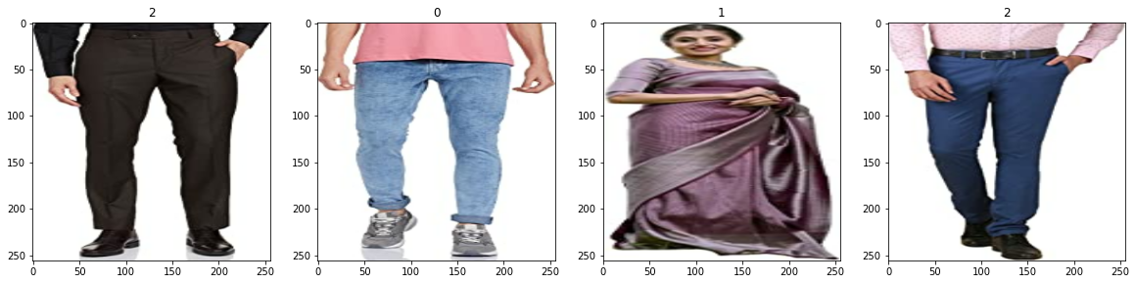
Visualizations
Plotting Numpy arrays as images: -
Observations:
Saree Images are represented by number 1, trouser by number 2 and jeans by number 0.

Slide 5
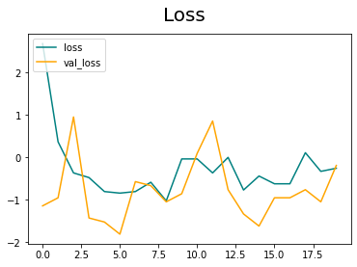
Visualizations
2. Loss History: -
Observations:
loss is decreasing at a moderate rate however Val_loss i.e Validation loss is not decreasing.

Slide 6
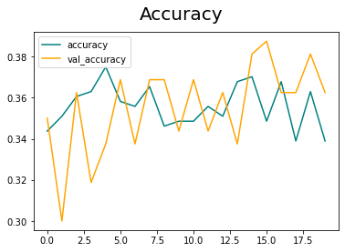
Visualizations
3. Accuracy History: -
Observations:
Validation accuracy is increasing at moderate rate however accuracy is not increasing.

Slide 7
Steps and Assumptions
Clean and organized the data.
Bifurcate images with filter of 'jpeg','jpg', 'bmp', 'png'
Classified the data into several batches
Divided Numpy array with 255 to make the array range between 0 to 1
Divided data into three parts i.e training, validation and testing data

Slide 8
Model Dashboard
Identification of possible problem
The data was not structured and organized hence cleaned the data using various data cleaning and pre-processing techniques.
There are so many images which are wrongly downloaded which are required to remove from database.
Accuracy was little low since the trouser and jeans seems same to the model.
Testing of Identified Approaches
CNN with Sequential Model the algorithms which have been used to train and test data.

Slide 9
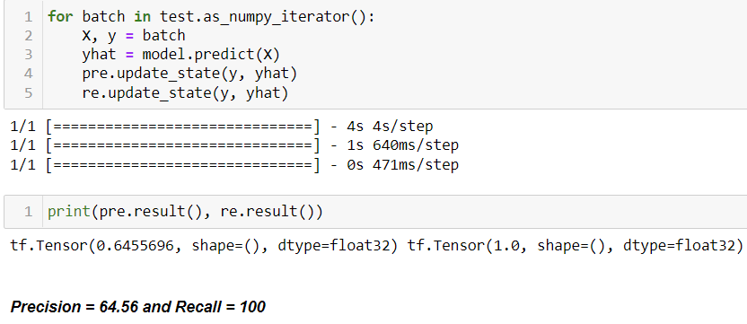
Model Dashboard
Sequential: -

Slide 10
Finalized Model
Key Findings and Conclusions of the Model
Have used Sequential Model to predict the image categories.
Precision is 65% and Recall is 100% for this model

Slide 11
Conclusion
Learning Outcomes of the Study in respect of Data Science
Data processing helps to bifurcate the categories and clean the data which will be used to make findings.
Data visualization helps understand and analyze the data.
Model building helps to predict outcomes, in this case Sequential model fits perfect for this dataset.

